Slide 1
R basics workshop
June 5-7, 2018, Missouri Botanical Garden
Network: MBGPUBLIC, password: mygarden
Website: http://rbasicsworkshop.weebly.com/

Slide 2
Instructors
J. Sebastián Tello
Center for Conservation and Sustainable Development
Missouri Botanical Garden
Iván Jiménez
Center for Conservation and Sustainable Development
Missouri Botanical Garden

Slide 3
Participants (1)
Abercrombie Ethan | Humboldt State University
Alejandra Vasco Gutierrez | Botanical Research Institute of Texas
Andrew Jesper | University of Illinois Urbana-Champaign
Bellangue David | Warren Wilson College
Brigette Williams | Saint Louis University
Chelsea Blumbergs | Austin Peay State University
Chelsea Teale | Humboldt State University
Colette Berg | Southeast Missouri State University
Daniel Sasson | Saint Louis University
Darin Penneys | University of North Carolina Wilmington
Deanna Deterding | Maryville University
Eric S. McCloud | University of Southern Indiana
Gates Marquise | Texas Lutheran University
Jorge Santiago-Blay | National Museum of Natural History
Klann Renee | Smith College

Slide 4
Participants (2)
Leonardo Galindo-González | University of Alberta
Leticia M. Classen Rodriguez | Saint Louis University
Liu Jonathan (Jani) | State University of New York
Megan Buchanan | Missouri Department of Conservation
Ming Wu | Washington University in St. Louis
Nigel Anderson | Purdue University
Nima Ehsani | Saint Louis University
O'Hallaron Benjamen | North Carolina State University
Patrick Glass | Maryville University
Rebecka Brasso | Southeast Missouri State University
Romi L. Burks | Southwestern University
Samundra Ambuhang Subba | WWF Nepal
Sandoval Marissa | University of California - Berkeley
Sara Johnson | University of Illinois:Urbana-Champaign
Sarah A. Douglass | University of Illinois Urbana-Champaign

Slide 5
Participants (3)
Shelby Whaley | Maryville University
Showalter Kelli | Washington University in St. Louis
Sterling Herron | Saint Louis University
Tatum VanDam | Colorado State University
Tess Rogers | World Bird Sanctuary
Worth Nia | Harris Stowe State University
Yap-Chiongco Ashlynn | St. Mary's College of California
Zenderland Jasmine | Humboldt State University

Slide 6
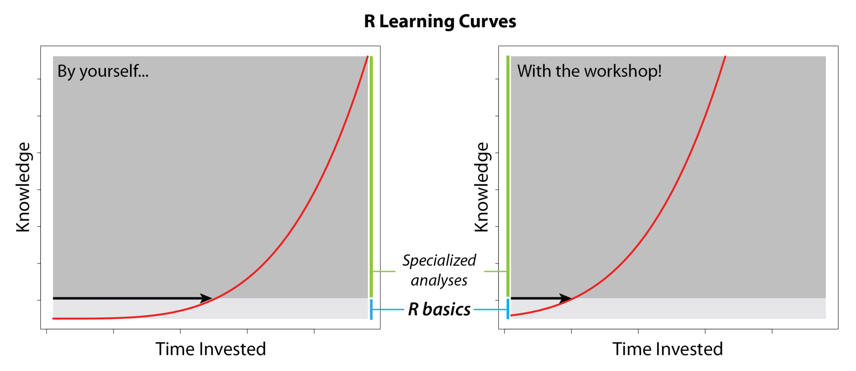
Objective
To teach the basic knowledge necessary to use R independently, thus helping participants initiate their own process of learning the specific tools needed for their research.

Slide 7
Logistics
3 days, 2 sessions each day: 8:00 am to noon and 1:30 pm to 5:00 pm
One 15-minute break during morning sessions, 10:15 am to 10:30, and one 15-minute break during afternoon sessions, 3:15 pm to 3:30 pm
Network: MBGPUBLIC, password: mygarden
Website: http://rbasicsworkshop.weebly.com/

Slide 8
General contents
Day 1
1. Introduction
2. Functions and arguments
3. Objects
Day 2
4. Opening and saving files
5. Operators
6. Object manipulation 7. Data generation
Day 3
8. Graphics
9. Flow control – loops and conditionals
10. Writing your own functions

Slide 9
1. Introduction

Slide 10
What is R?
R is a language and environment for statistical computing and graphics. Environment = planned and coherent system of flexible tools (“An Introduction to R” by R Core Team). R can be used for: data manipulation, data analysis, creating graphs, designing and running computer simulations.
R is extended by thousands of packages described in “Task Views” at CRAN (The Comprehensive R Archive Network): https://cran.r-project.org/web/views/
Notes:
R is a statistical computing environment for statistical computation and graphics, and it is a computer language designed for typical and possibly very specialized statistical and graphical applications. The software is available for unix/linux, Windows, and Macintosh platforms
under general public license, and the program is available to download from www.r-project.org. Thousands of contributed packages are also available as well as utilities for easy installation.

Slide 11
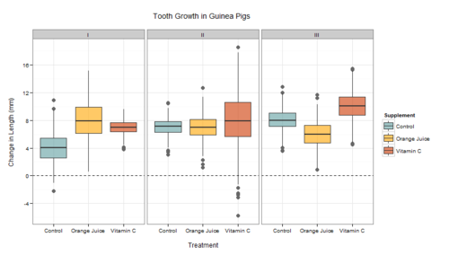
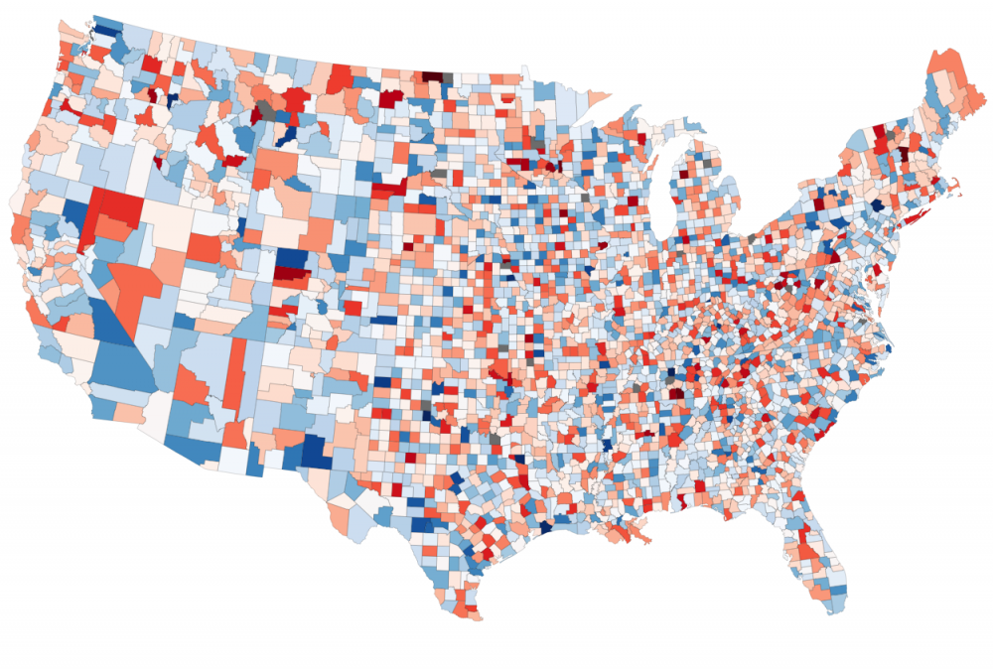
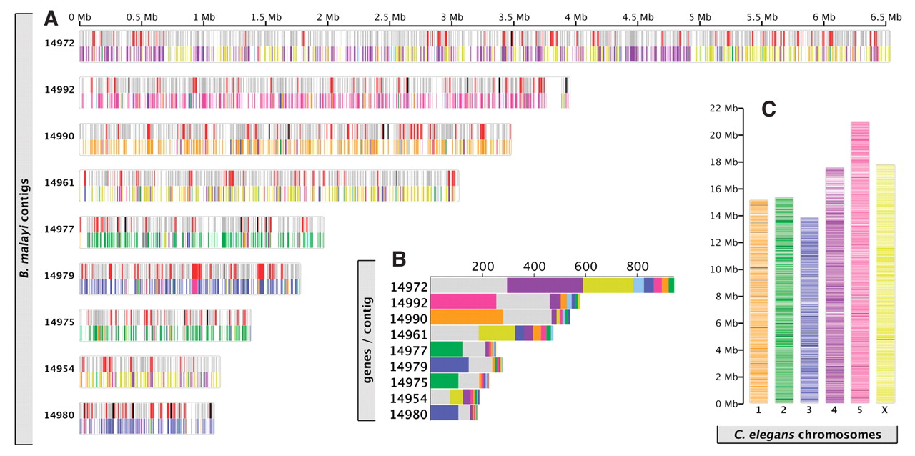
Why use R?
It is free
Excellent for graphics
Tools for a wide range of statistical analyses
Recently developed tools available immediatly
Freedom to develop your own tools
Notes:
R is a statistical computing environment for statistical computation and graphics, and it is a computer language designed for typical and possibly very specialized statistical and graphical applications. The software is available for unix/linux, Windows, and Macintosh platforms
under general public license, and the program is available to download from www.r-project.org. Thousands of contributed packages are also available as well as utilities for easy installation.

Slide 12
How to get R
From www.r-project.org. R is a GNU project.

Slide 13
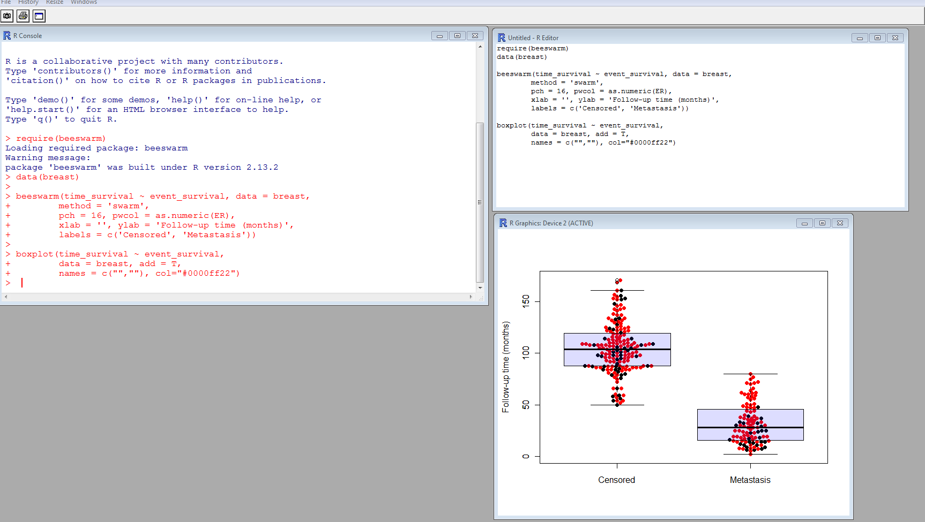
Three windows in R
Graphics
Console
Editor

Slide 14
Exercise 1.1: a sample R session
Objective: experiencing R

