Slide 1
R basics workshop
June 6-9, 2023, Missouri Botanical Garden
Network: MBGPUBLIC, password: mygarden
Website: http://rbasicsworkshop.weebly.com/

Slide 2
Instructors
J. Sebastián Tello
Center for Conservation and Sustainable Development
Missouri Botanical Garden
Iván Jiménez
Center for Conservation and Sustainable Development
Missouri Botanical Garden

Slide 3
Participants (1)
Adam Rembert | Missouri Botanical Garden
Ajith Ashokan | University of Missouri - St. Louis
Aliya Swearngin | Grinnell College
Allison Rea | Washington University in St. Louis
Colin Robinson | Missouri Botanical Garden
Daniel M Tarazona Ocana | Missouri Botanical Garden
Delcee Ramos | Weber State University
George Todd | University of Missouri - St. Louis
Heather Smith | Appalachian State University
Jeremiah Westerman | University of New Mexico
Jorge Robles | MiraCosta College
Kayla Flamm | Missouri Botanical Garden
Kendall Cross | St. Cloud State University
Liang Zhang | Kunming Institute of Botany
Luka Sato | Brown University

Slide 4
Participants (2)
Maria Query | Salem State University
Maura Collins | Washington University in St. Louis
Michelle Cao | Dickinson College
Molly Rooney | Missouri Botanical Garden
Raj Prasai | University of Missouri - St. Louis
Rosa del C. Ortiz | Missouri Botanical Garden
Sebastian Forward | University of Missouri - St. Louis
Sierra McWaine | Praire View A&M University

Slide 5
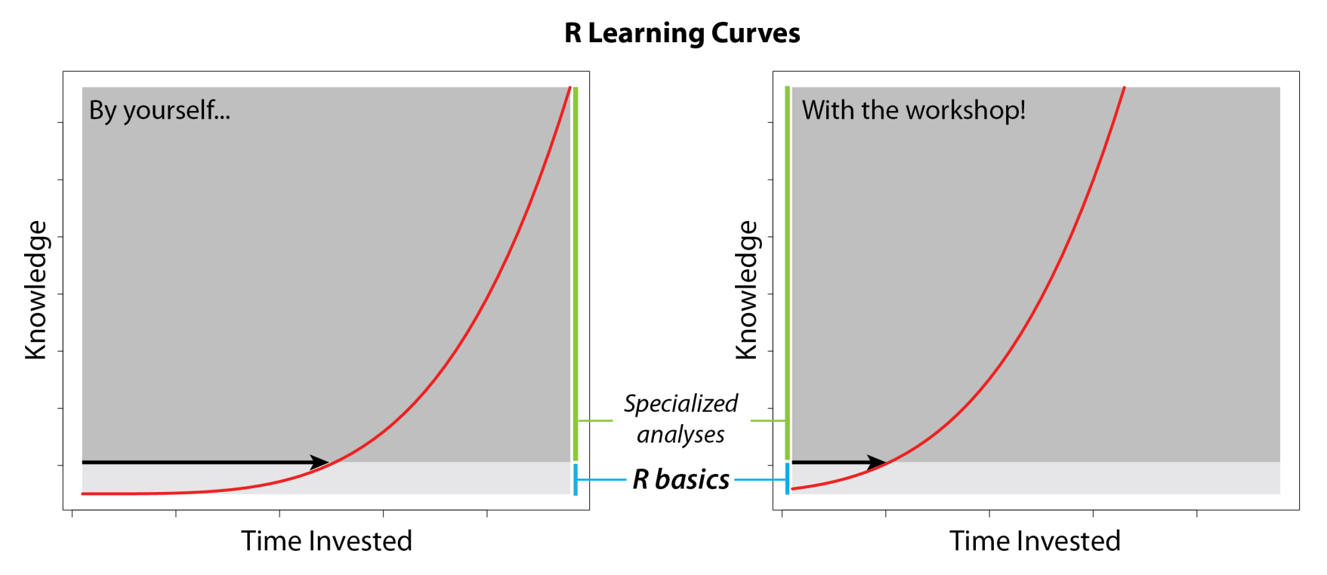
Objective
To teach basic knowledge necessary to use R independently, thus helping participants to undertake more specialized analyses.

Slide 6
Logistics
4 days, 2 sessions each day: 9:00 am to noon and 1:30 to 4:00 pm
A morning break from 10:30 to 10:45 am and an afternoon break from 2:45 to 3:00 pm
Network: MBGPUBLIC, password: mygarden
Website: http://rbasicsworkshop.weebly.com/

Slide 7
General contents
Day 1
1. Introduction – Iván
2. Functions and arguments – Sebastián
3. Objects – Sebastián
Day 2
4. Opening and saving files – Sebastián
5. Operators – Iván
6. Object manipulation – Iván Day 3
7. Data generation – Iván
8. Graphics – Iván
Day 4
9. Flow control – loops and conditionals – Sebastián
10. Writing your own functions – Iván

Slide 8
1. Introduction

Slide 9
What is R?
R is a language and environment for statistical computing and graphics. Environment = planned and coherent system of flexible tools (“An Introduction to R” by R Core Team). R can be used for: data manipulation, data analysis, creating graphs, designing and running computer simulations.
R is extended by thousands of packages, some described in “Task Views” at The Comprehensive R Archive Network (CRAN).
Notes:
R is a statistical computing environment for statistical computation and graphics, and it is a computer language designed for typical and possibly very specialized statistical and graphical applications. The software is available for unix/linux, Windows, and Macintosh platforms under general public license, and the program is available to download from www.r-project.org. Thousands of contributed packages are also available as well as utilities for easy installation.

Slide 10
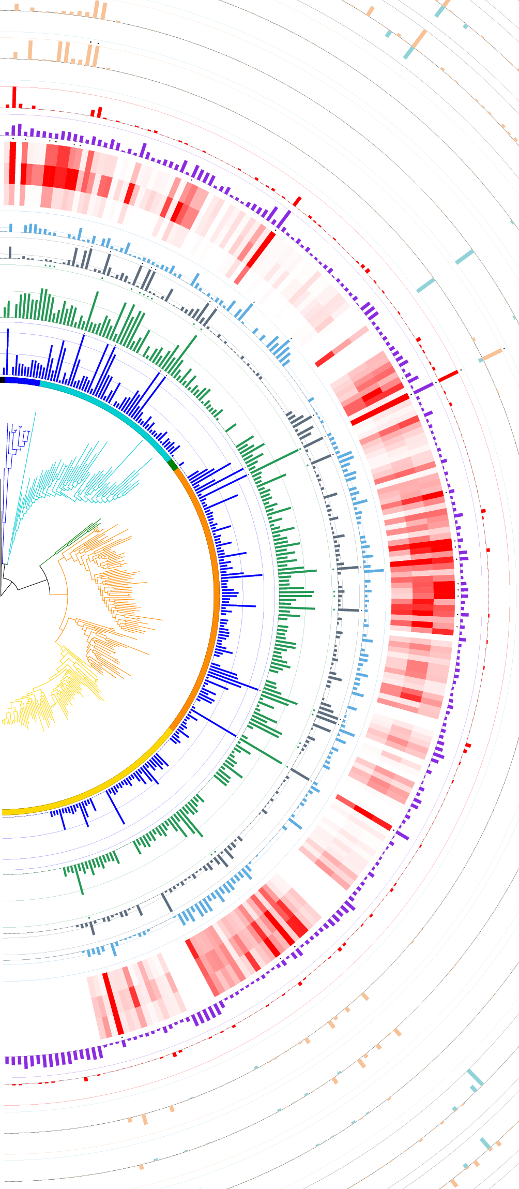
Why use R?
It is free
Excellent for graphics
Tools for a wide range of statistical analyses
Recently developed tools available immediately
Freedom to develop your own tools
itol.toolkit: access the Interactive Tree of Life to edit and annotate trees interactively.

Slide 11
Artificial intelligence and R
Several R packages implement machine learning: https://cran.r-project.org/web/views/MachineLearning.html
Large language models, such as Generative Pre-trained Transformer 3 and 4 (GPT-3 and GPT-4), serve as R coding assistants: ChatGTP tools for R programming

Slide 12
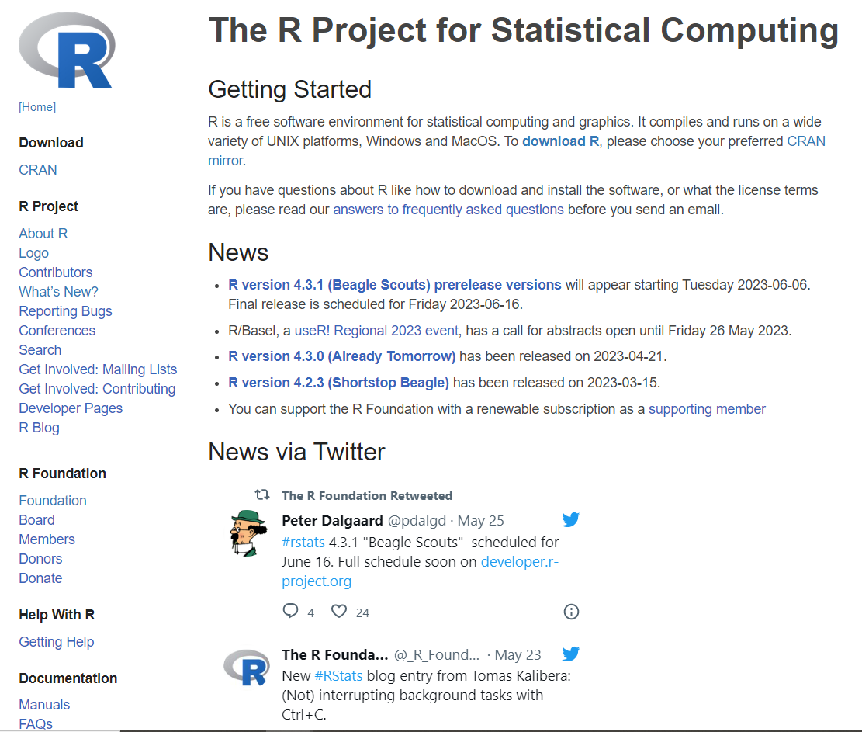
How to get R
From www.r-project.org. R is a GNU project.

Slide 13
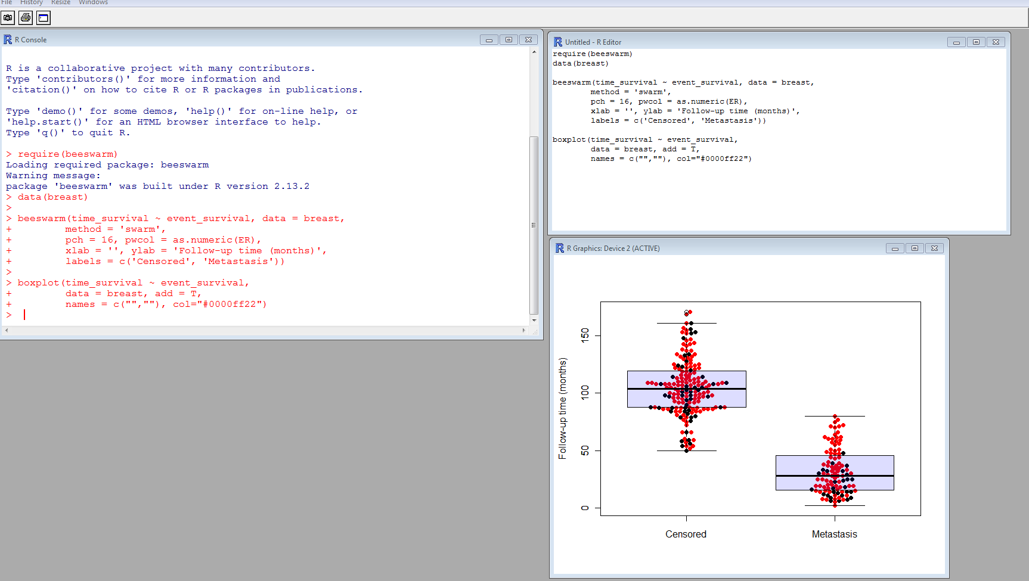
Three windows in R
Graphics
Console
Editor

Slide 14
Exercise 1.1: a sample R session
Objective: experiencing R

